Slide 1
DATA 300 Statistical Machine Learning
Chapter 3: Linear regression

Slide 2
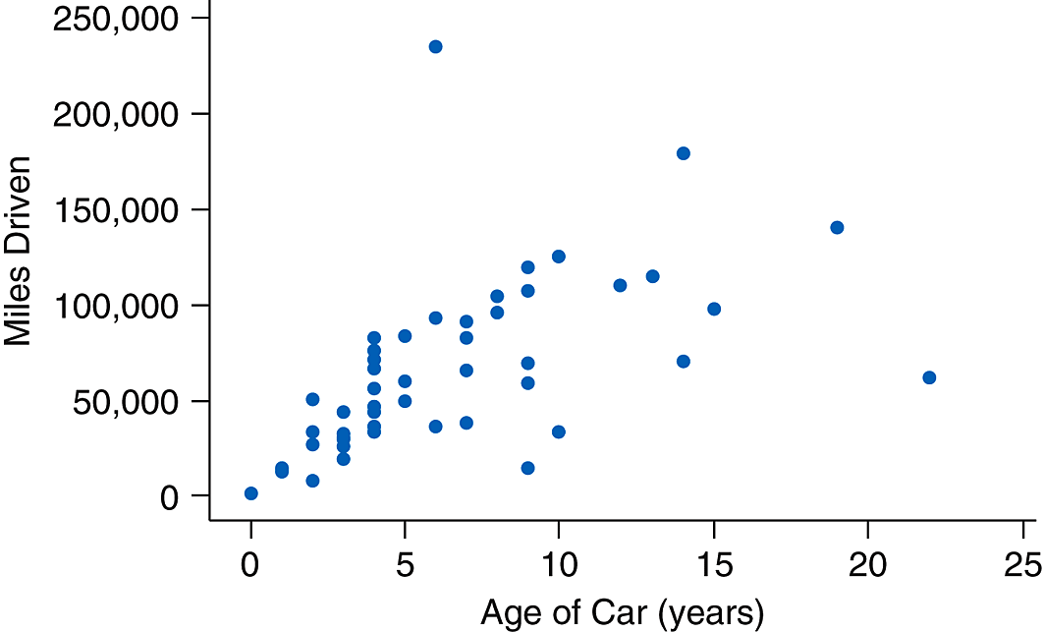
Linear regression
Linear regression is to assume a linear relationship between the predictors and the response.
What is a linear relationship?
Assuming b is a parameter, which one of the following assumes a linear relationship between age and milesdriven?
MilesDriven = b*Age
Miles Driven = exp(b*Age)

Slide 3
Linear regression
Linear regression is to assume a linear relationship between the predictors and the response.
What is a linear relationship?
A linear relationship must have the following form:
y = a + bx
where x is a predictor, and y is the response. Further, a is the intercept, b is the slope.

Slide 4
Linear regression
Linear regression is to assume a linear relationship between the predictors and the response.
What is a linear relationship?
A linear relationship must have the following form:
y = a + bx
where x is a predictor, and y is the response. a and b are parameters, where a is the intercept and b is the slope.
What if there are multiple predictors?

Slide 5
Linear regression
Linear regression is to assume a linear relationship between the predictors and the response.
A linear regression takes the following form:
y = b₀ + b₁x₁ + b₂x₂ + … + b_{D}x_{D}
where D is the total number of variables.
Notes:
Multiple linear regression

Slide 6
Linear regression
Linear regression is to assume a linear relationship between the predictors and the response.
A linear regression takes the following form:
y = b₀ + b₁x₁ + b₂x₂ + … + b_{D}x_{D}
where D is the total number of variables.
The goal of linear regression is to calculate b₀, b₁, b₂, …, b_{D} so that the model best fits the training set.

Slide 7
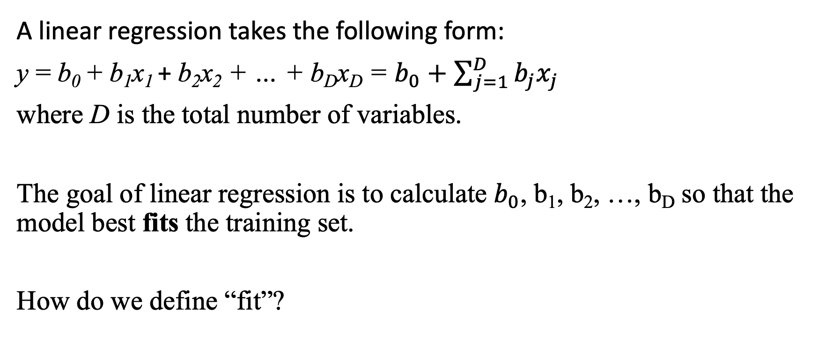
The objective of linear regression
A linear regression takes the following form:
y = b₀ + b₁x₁ + b₂x₂ + … + b_{D}x_{D} = $b_{0}+\sum_{j=1}^{D}{b_{j}x_{j}}$
where D is the total number of variables.
The goal of linear regression is to calculate $b_{0}$, b₁, b₂, …, b_{D} so that the model best fits the training set.
How do we define “fit”?

Slide 8
Model “fit”
Which line is a better fit, green or yellow? Why?

Slide 9
Model “fit”
The most classical way to decide ”fit“ is to measure how big of a “mistake” the model made on the training set.

Slide 10
Model “fit”
Which line is a better fit, orange or yellow?
Alternatively, what information do you need to decide which line is a better fit?

Slide 11
Model “fit”
The most classical way to decide ”fit“ is to measure how big of a “mistake” the model made on the training set.
For Age = 10, the yellow time (model) thinks the car should have (around) 100k miles.
In our sample, the 10-year-old car has a mileage of less than 50k.
In other words, the model made a (100k-50k) mistake for this sample unit.

Slide 12
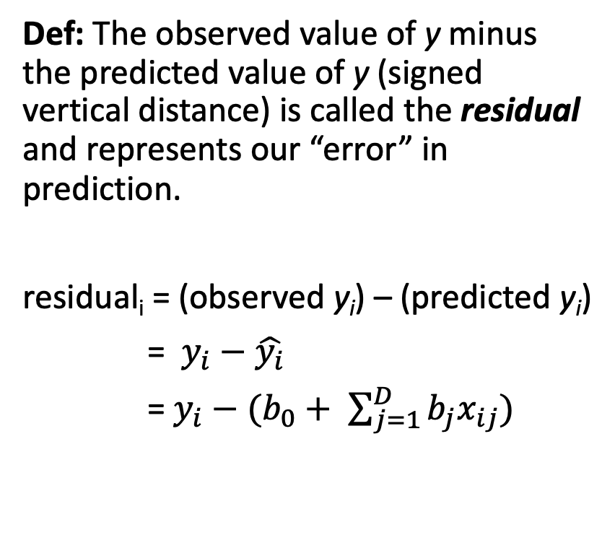
Residual
Def: The observed value of y minus the predicted value of y (signed vertical distance) is called the residual and represents our “error” in prediction.
residual_{i} = (observed y_{i}) – (predicted y_{i})
= $y_{i}−\hat{y_{i}}$
= $y_{i}−(b_{0}+ \sum_{j=1}^{D}{b_{j}x_{ij})}$

Slide 13
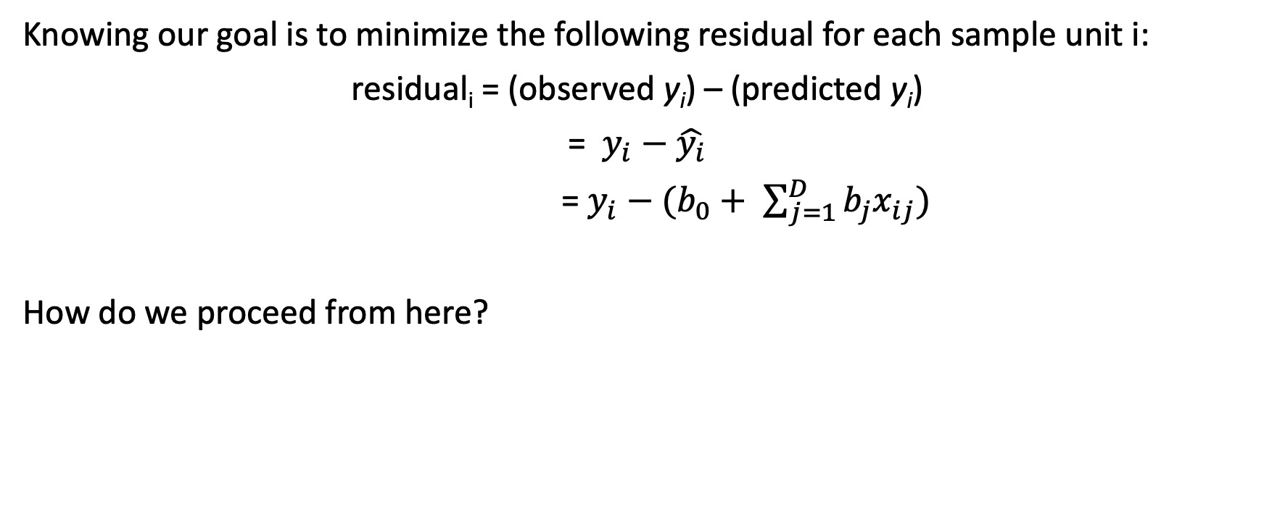
The objective of linear regression
Knowing our goal is to minimize the following residual for each sample unit i:
residual_{i} = (observed y_{i}) – (predicted y_{i})
= $y_{i}−\hat{y_{i}}$
= $y_{i}−(b_{0}+ \sum_{j=1}^{D}{b_{j}x_{ij})}$
How do we proceed from here?

Slide 14
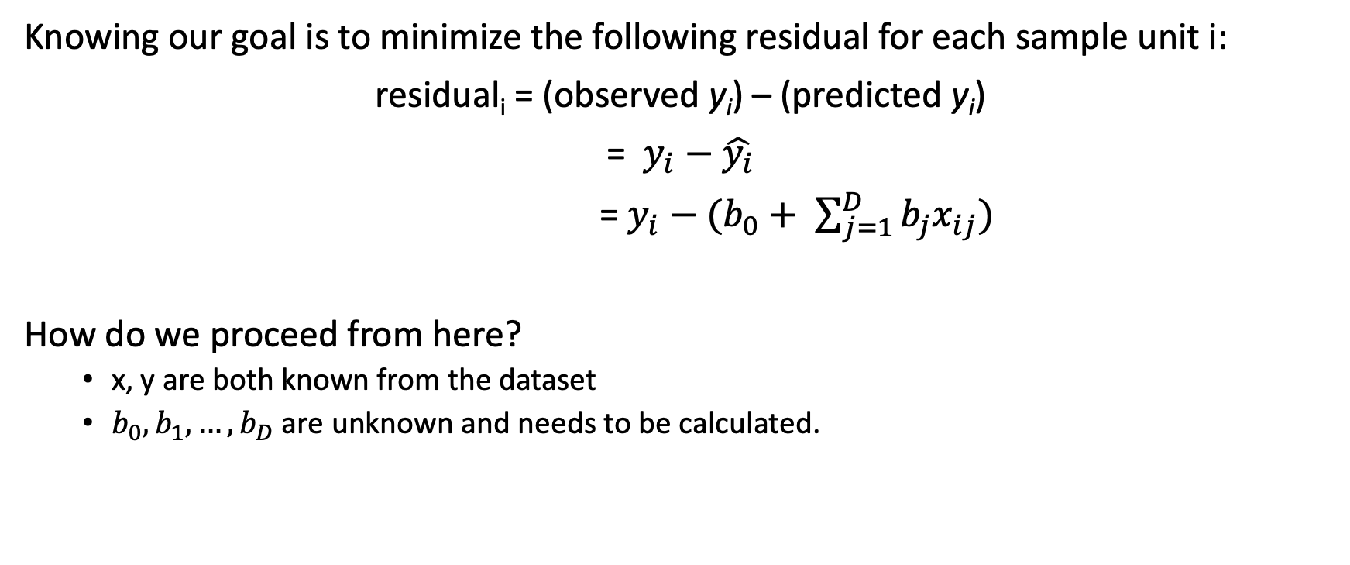
The objective of linear regression
Knowing our goal is to minimize the following residual for each sample unit i:
residual_{i} = (observed y_{i}) – (predicted y_{i})
= $y_{i}−\hat{y_{i}}$
= $y_{i}−(b_{0}+ \sum_{j=1}^{D}{b_{j}x_{ij})}$
How do we proceed from here?
x, y are both known from the dataset
$b_{0},b_{1},…,b_{D}$ are unknown and needs to be calculated.

Slide 15
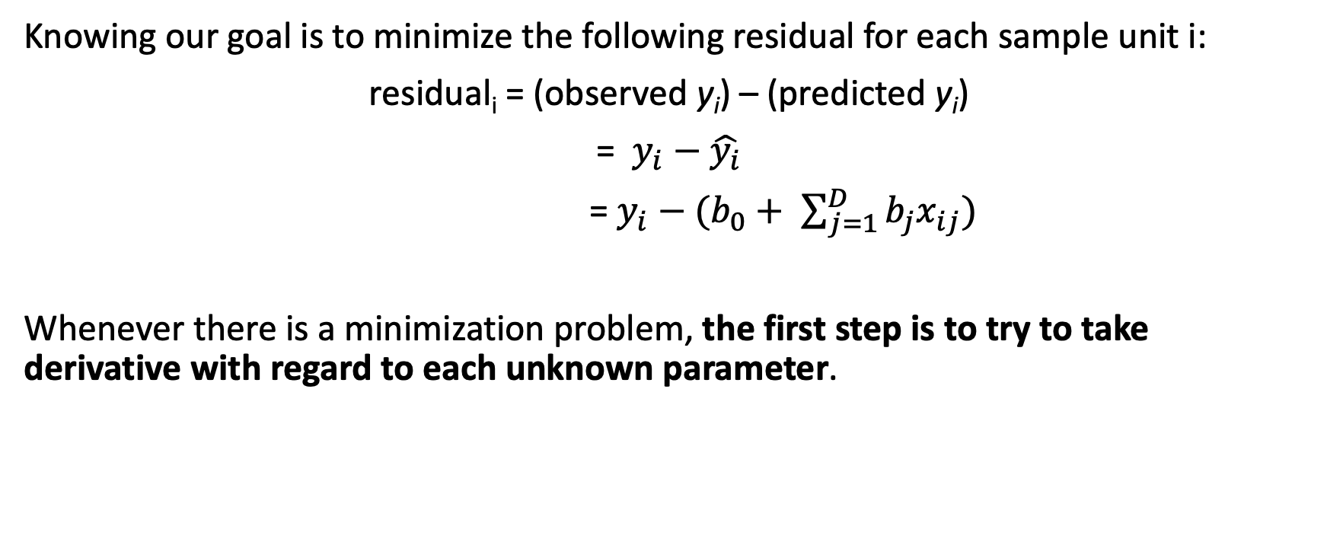
The objective of linear regression
Knowing our goal is to minimize the following residual for each sample unit i:
residual_{i} = (observed y_{i}) – (predicted y_{i})
= $y_{i}−\hat{y_{i}}$
= $y_{i}−(b_{0}+ \sum_{j=1}^{D}{b_{j}x_{ij})}$
Whenever there is a minimization problem, the first step is to try to take derivative with regard to each unknown parameter.

Slide 16
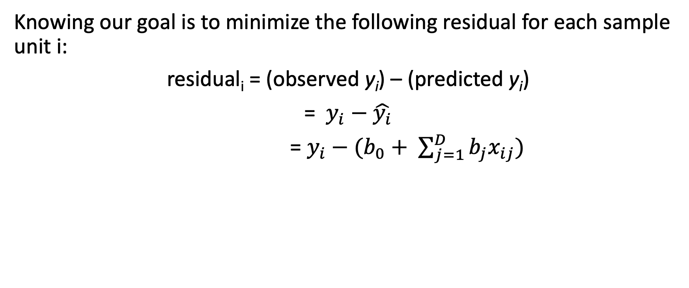
Exercise: form the objective function of linear regression
Knowing our goal is to minimize the following residual for each sample unit i:
residual_{i} = (observed y_{i}) – (predicted y_{i})
= $y_{i}−\hat{y_{i}}$
= $y_{i}−(b_{0}+ \sum_{j=1}^{D}{b_{j}x_{ij})}$

Slide 17
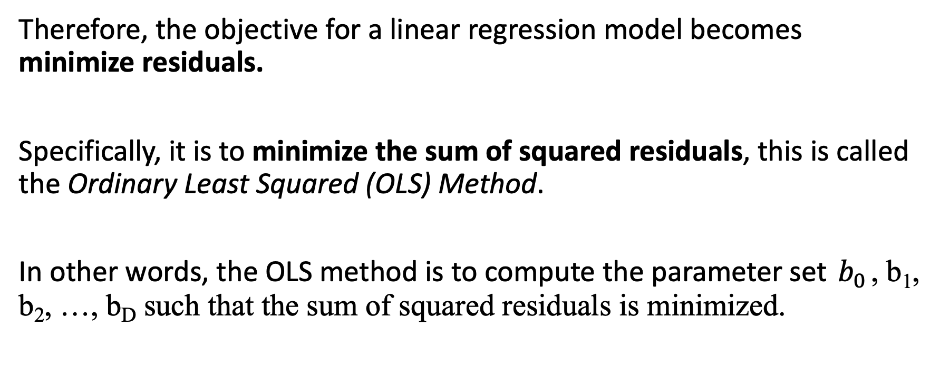
Objective function for linear regression
Therefore, the objective for a linear regression model becomes minimize residuals.
Specifically, it is to minimize the sum of squared residuals, this is called the Ordinary Least Squared (OLS) Method.
In other words, the OLS method is to compute the parameter set $b_{0}$, b₁, b₂, …, b_{D} such that the sum of squared residuals is minimized.

Slide 18
OLS derivation

Slide 19
OLS derivation

